Slide 1
Iot
Internet of Things (internet of everything?)

Slide 2
Learning Objectives
Get an idea of what IoT is
Get an overview of the course
Learn the very basics of linux / RPi
Learn the very basics of python - among other PyCharm
Be able to write simple python programs to control a RPi’s GPIO, to make a robot walk, read from web camera and other sensors
Be able to document and present your work
Revised from Ebbe Vang

Slide 3
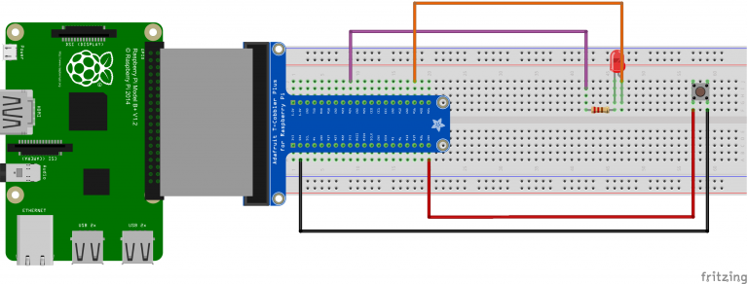
Todays Agenda
Some Introduction to IoT - What is it?
Introduction to Raspberry Pi - What to expect?
Basic linux commands - navigate in the console and other basic operations
A simple program to control a LED - learn how to wire the pins of the RPi
Near future
Adding a button to our RPi - a slightly more complete exercise
Python Exercise - Improve on your python skills...
Revised from Ebbe Vang

Slide 4
Course overview
5 weeks: Introduction to IOT, Python, Linux and sensors
Small exercises and training in electronics and python programming
3 weeks: Mandatory Project: An IoT device
More exercises and introducing new sensors, displays, inputs etc
Work on IoT project in groups
Documenting your device – for www.dimselab.dk
Demonstrate / Presentation of your device
2 weeks of Mandatory presentation : Present a paper / article
10 min Presentation for the class
5 weeks of Specialization
Guidance on your specialization
Revised from Ebbe Vang

Slide 5
Mandatory Project
You have to build an IoT device for the ??? in groups of two- three members.
Your device can be almost anything as long as it reflects the course and can be used in ?<coming>?
Ideas for your mandatory could be:
Game battle between robots
Intelligent decoration
Monitoring …
…
Revised from Ebbe Vang

Slide 6
Specialization
For exam you have to do a specialization
You choose a topic from one of your elective courses
You get guidance
You write a paper (8 pages)
You go to an oral exam in your chosen topic
Revised from Ebbe Vang

Slide 7
Mandatory Project
Your IoT device must be extensively described in details on the IoT blog (www.dimselab.dk). Your blog post must include:
Names of everyone in the group
Description of the device’s purpose
Description of how you came up with the idea
Description of how you created the device
Fritzing diagram describing your wiring
The code you wrote to make it work
Pictures showing your device in use
Revised from Ebbe Vang

Slide 8
so… What is this internet-of-things?
Some definitions
Revised from Ebbe Vang

Slide 9
The Internet of Things (IoT) is the network of physical objects, devices, vehicles, buildings and other items which are embedded with electronics, software, sensors, and network connectivity, which enables these objects to collect and exchange data.
[Wikipedia]
Revised from Ebbe Vang

Slide 10
The Internet of Things (IoT) is an environment in which objects, animals or people are provided with unique identifiers and the ability to transfer data over a network without requiring human-to-human or human-to-computer interaction.
[techTarget.com]
Revised from Ebbe Vang

Slide 11
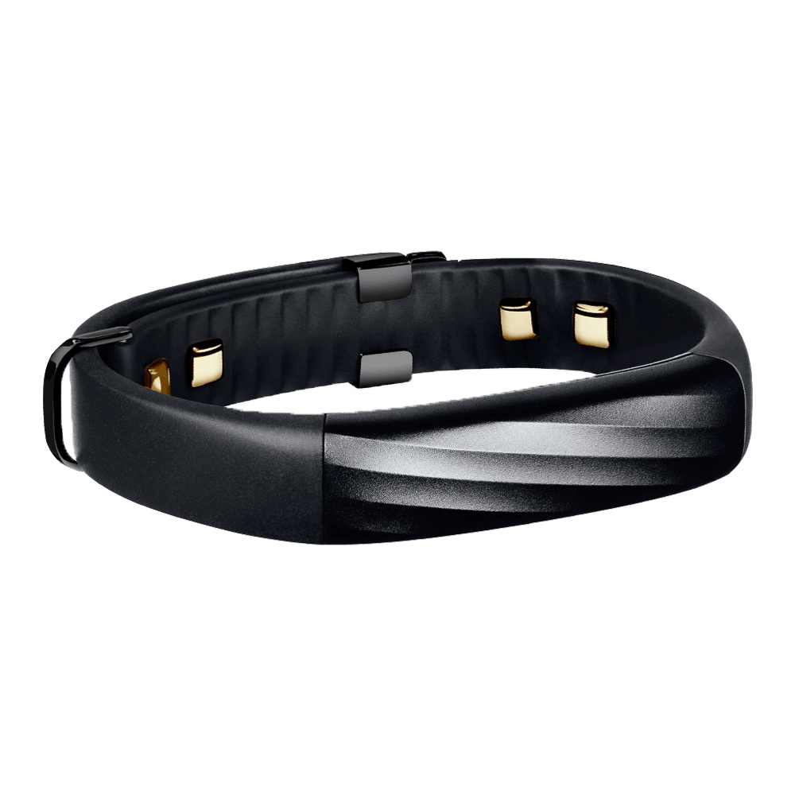
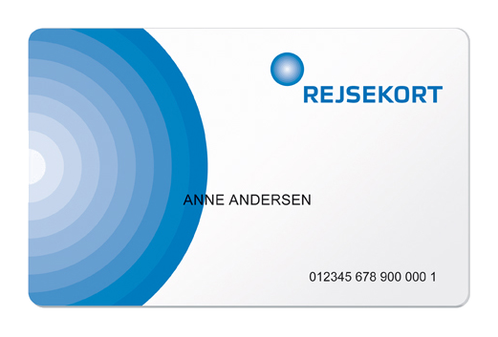
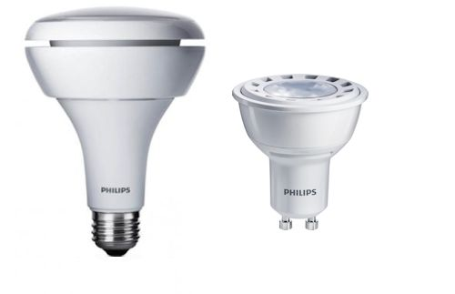
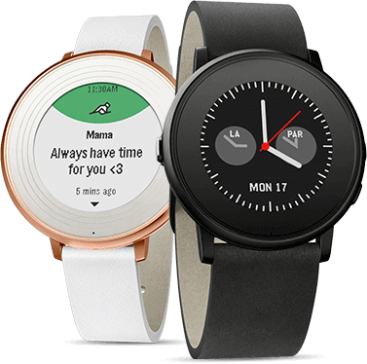
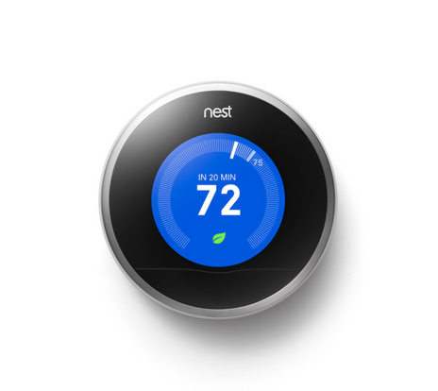
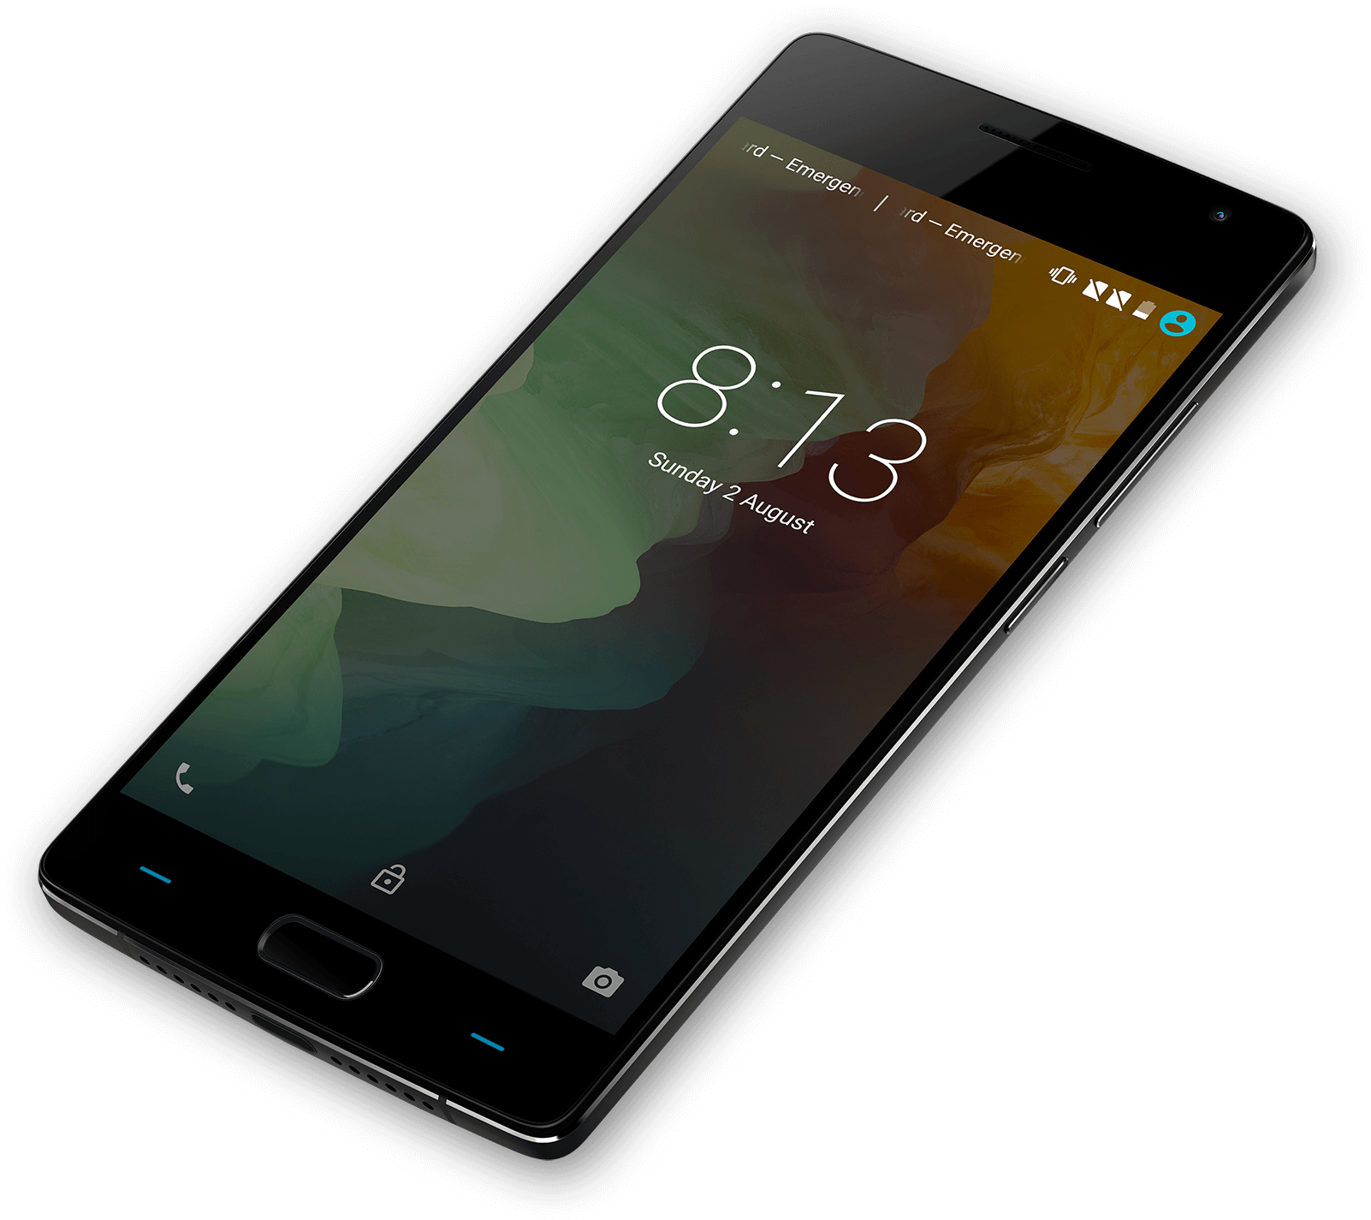
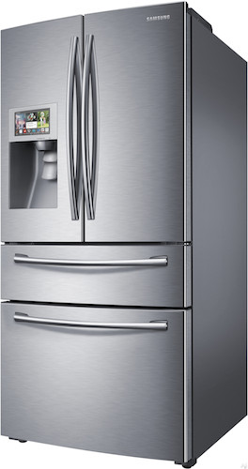
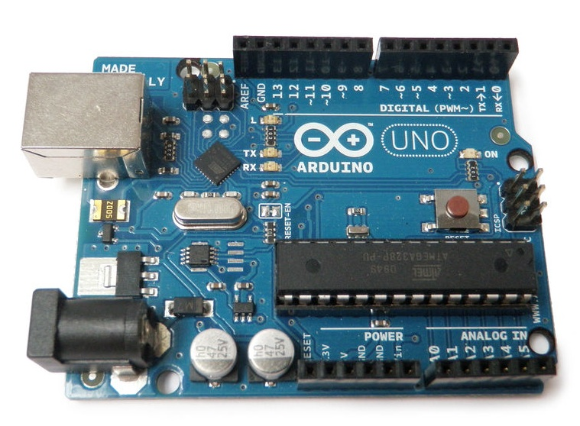
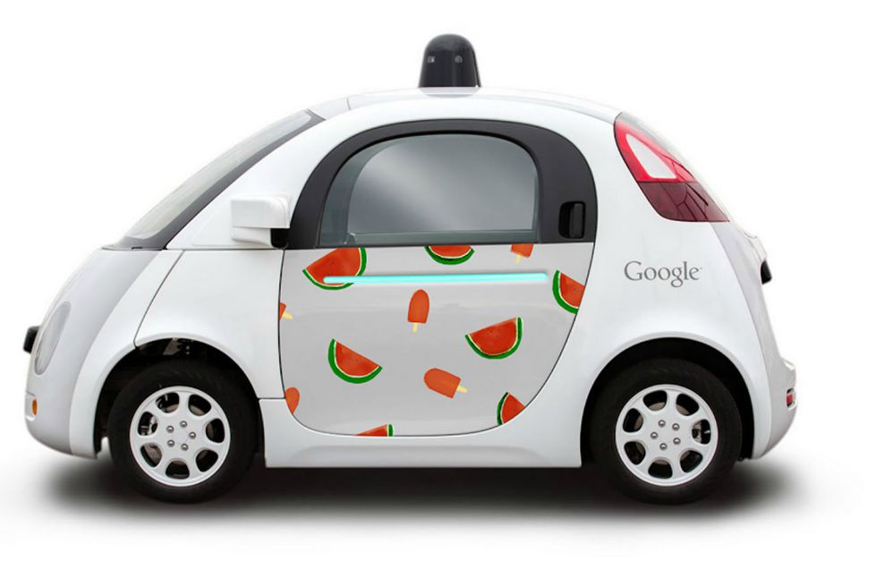
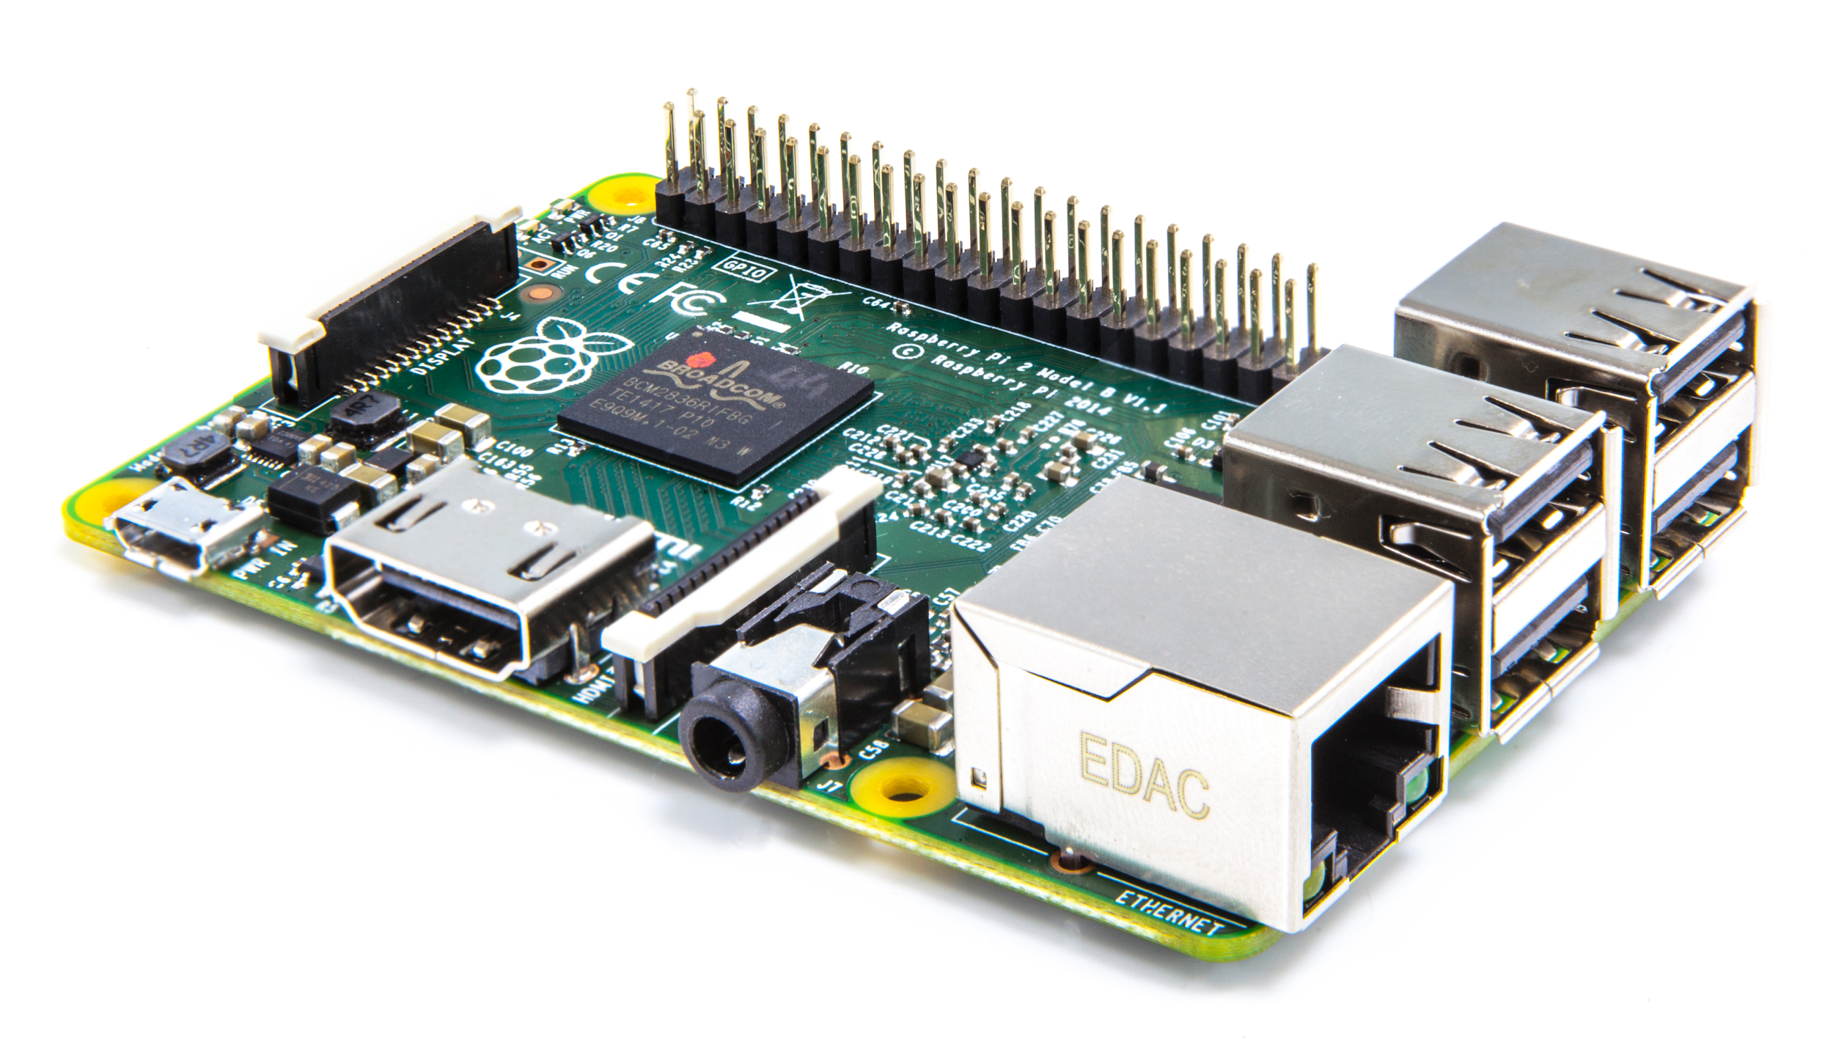
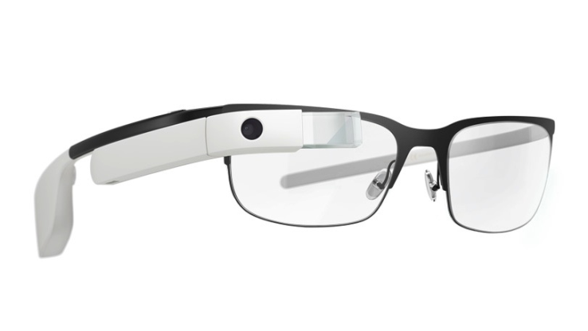
Internet of things
Revised from Ebbe Vang

Slide 12
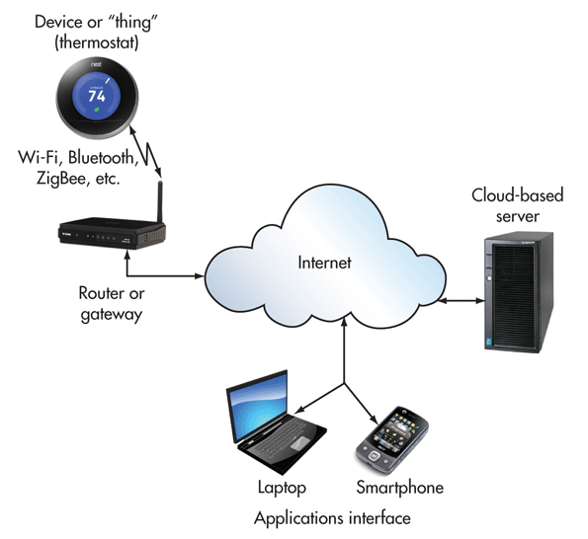
Get Connected
Some examples:
IBM + ISS Smarter Building : https://www.youtube.com/watch?v=mk0C_rRhMOw
Introduction to Lora
https://www.lora-alliance.org/What-Is-LoRa/LoRaWAN-Videos
Revised from Ebbe Vang

Slide 13
exercise
Find your favourite IoT device and tell us why
Revised from Ebbe Vang

Slide 14
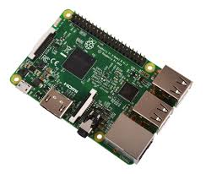
Raspberry Pi
Small computer – though not as small as other IoT’s
Can run different OS’s
most often Linux – Raspbain a Dedian variant, but also Windows 10, Ubuntu, osmc, risk os
Competing to Arduino
Have All kind of plugs (HDMI,RJ45,USB,micro SD …)
besides all the pins
Revised from Ebbe Vang

Slide 15
What is
High level Language
general purpose
Interpreted
Interactive
Object Oriented
Clear syntax
Modules Libraries
Portable
Interpreter directly
Interpreter shell
IDE to python
Nano, PyCharm (JetBrains)
Revised from Ebbe Vang

Slide 16
The End / Evaluation
Did things go as expected?
Revised from Ebbe Vang

